Slide 1

Advanced Maps
Chris Piech
CS106A, Stanford University

Slide 2
My First Map
animalSoundMap
“ow
ow
ow”
Values:
“bark”
“meow”
Keys:
“dog”
“seal”
“cat”
// 1. Make a new map
HashMap<String, String> animalSoundMap =
new HashMap<String, String>();
// 2. Put things into the map
animalSoundMap.put("dog", "woof");
animalSoundMap.put("cat", "meow");
animalSoundMap.put("seal", "ow ow ow");
// 3. Get things out of the map
animalSoundMap.get("dog"); // "woof"
animalSoundMap.get("fox"); // null

Slide 3
My First Map
animalSoundMap
“ow
ow
ow”
Values:
“bark”
“meow”
Indeces:
0
1
2
// 1. Make a new list
ArrayList<String> animalSounds =
new ArrayList<String>();
// 2. Put things into the list
animalSoundMap.add("woof");
animalSoundMap.add("meow");
animalSoundMap.add("ow ow ow");
// 3. Get things out of the list
animalSoundMap.get(0); // "woof”

Slide 4
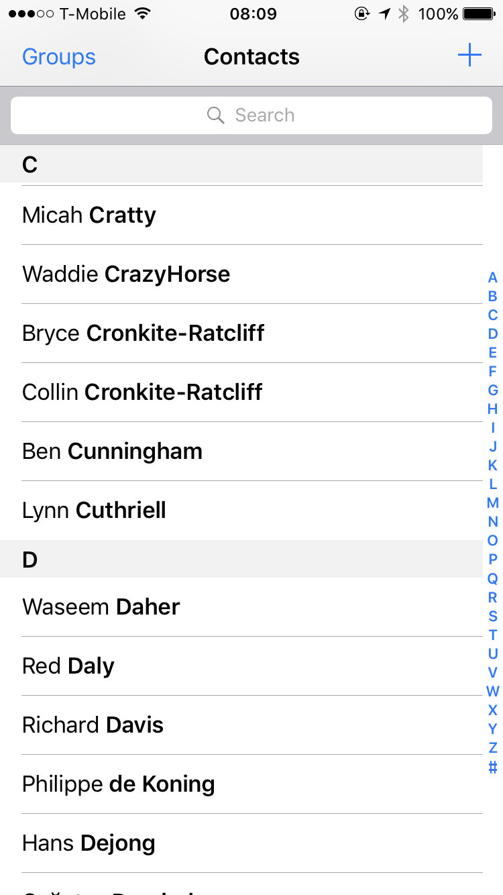
Phone Book
6701678

Slide 5
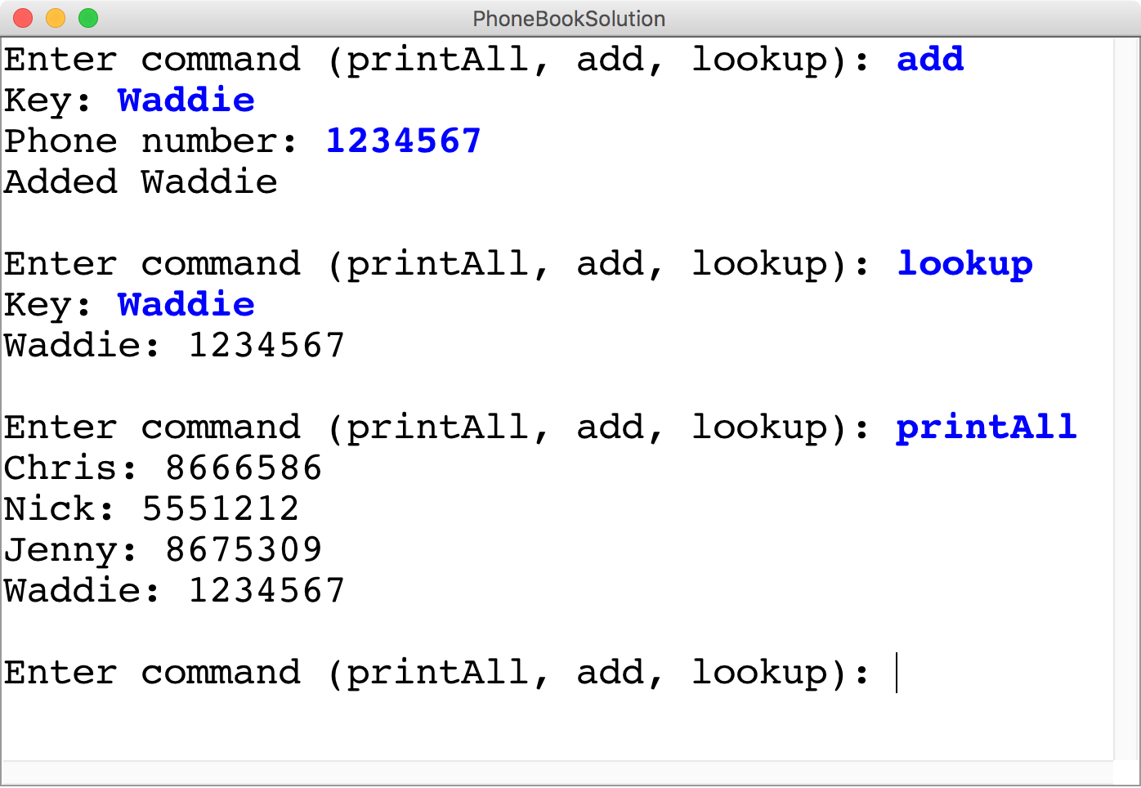
Phone Book

Slide 6
HashMaps on one slide
Make a HashMap
Put and get values into a map
Some useful other methods
int size = myMap.size();
myMap.contains(key); // returns true or false if key is in map
myMap.keySet();
myMap.remove(key); // make like a tree and leave!
Iterate using a foreach loop
HashMap<KeyType, ValueType> myMap =
new HashMap<KeyType, ValueType>();
myMap.put(key, value);
myMap.get(key) // returns the corresponding value
for(keyType key : myMap.keySet()){ // not ordered
myMap.get(key); // do something with the key/value pair }

Slide 7
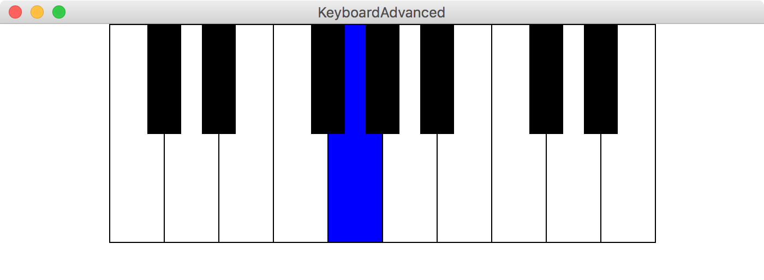
Make a keyboard

Slide 8
Aside: AudioClips
AudioClip soundFile =
MediaTools.loadAudioClip(fileName);
soundFile.play();

Slide 9
Aside: Split
String str
= “Life is short. Live passionately.”;
String[] words = str.split(“ ”);
words
“passionately.”
“Life”
was
“is”
was
“short.”
“Live”
0
1
2
3
4

Slide 10
Aside: Split
String str
= “Life is short. Live passionately.”;
String[] words = str.split(“.”);
words
“Life is short”
“Live passionately”
0
1

Slide 11
Make a keyboard

Slide 12
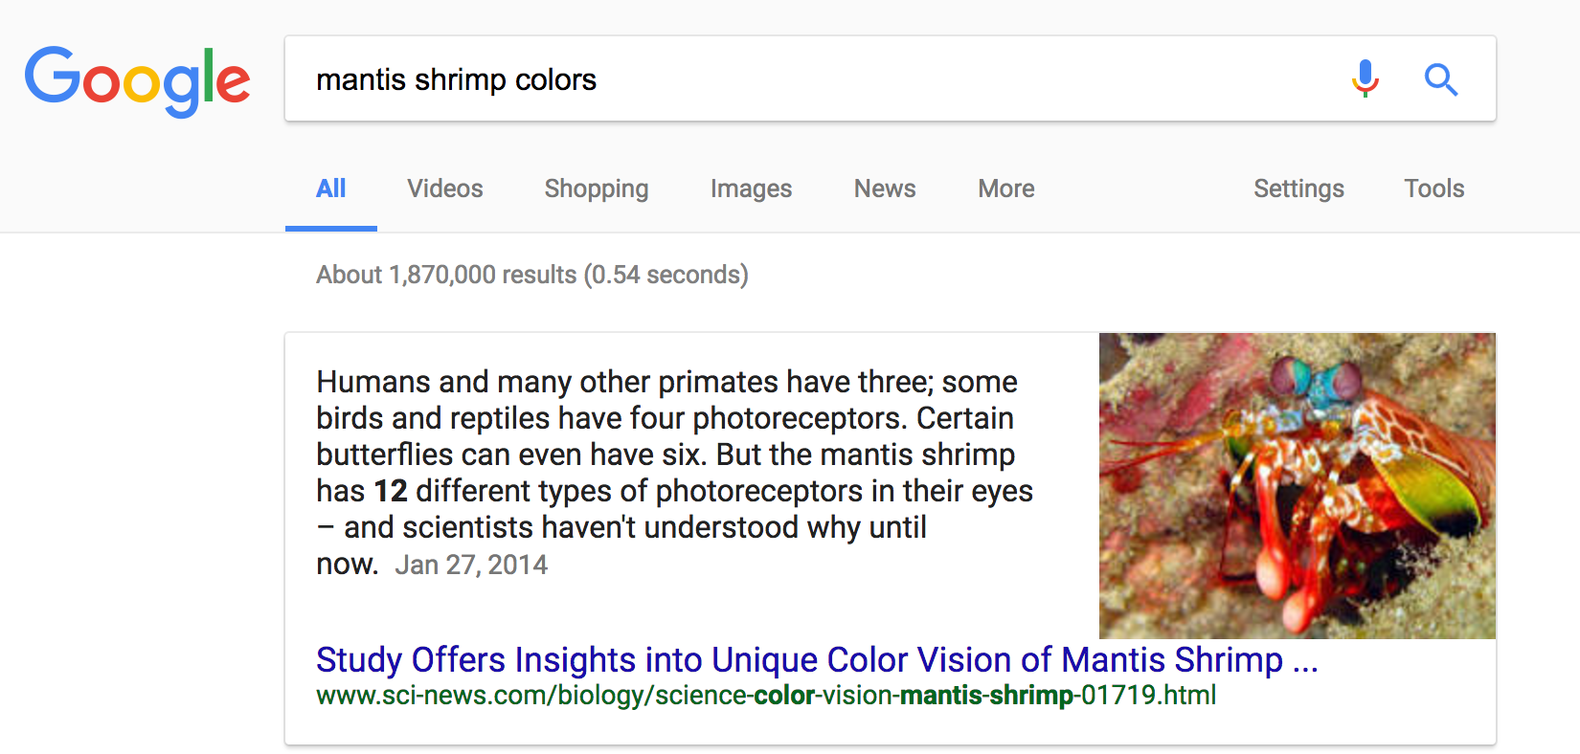
Why is this so fast?

Slide 13
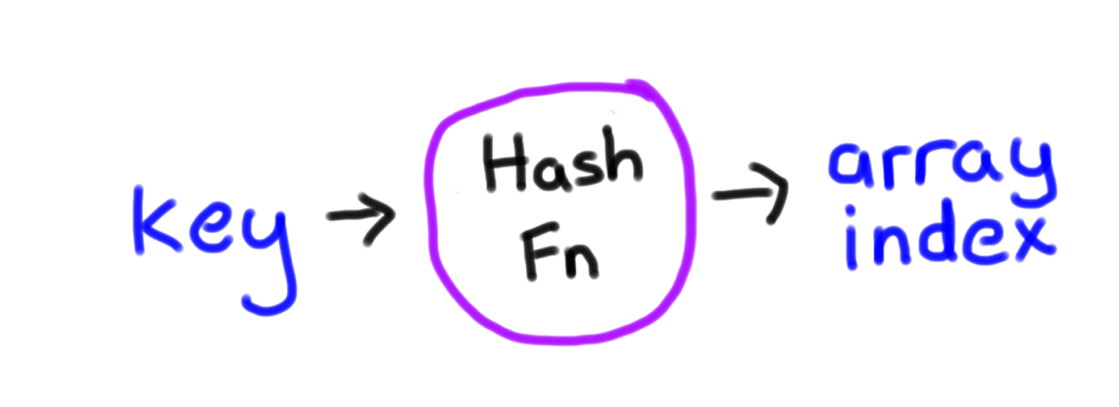
Why is this so fast?
int hash(string key);
* Learn more in CS106B

Slide 14
Why is this so fast?

Slide 15
Interactors

Slide 16
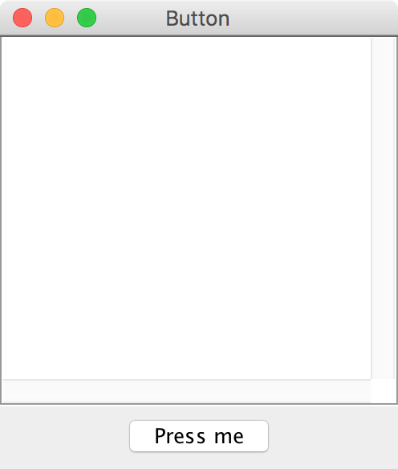
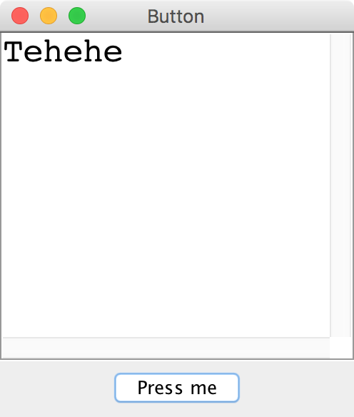
Button

Slide 17
Adding Iteractors
When you create an instance of any Program subclass, Java divides the window area into five regions as follows:
NORTH
WEST
EAST
CENTER
SOUTH
The CENTER region is typically where the action takes place. A ConsoleProgram adds a console to the CENTER region, and a GraphicsProgram puts a GCanvas there.
The other regions are visible only if you add an interactor to them. The examples in the text use the SOUTH region as a control strip containing a set of interactors, which are laid out from left to right in the order in which they were added.

Slide 18
JComponents
JComponent
JButton
JLabel
JTextField

Slide 19
JButton

Slide 20
JButton
JButton button = new JButton("Press me");

Slide 21
JButton
Button Text
JButton button = new JButton("Press me");

Slide 22
JButton
JButton button = new JButton("Press me");
add(button, SOUTH);

Slide 23
JButton
public void actionPerformed(ActionEvent e) {
println(e.getActionCommand());
}

Slide 24
JLabel

Slide 25
JLabel
JLabel label = new JLabel("Hi");

Slide 26
JLabel
JLabel label = new JLabel("Hi");

Slide 27
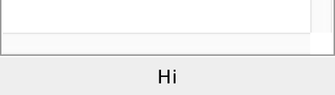
JLabel
JLabel label = new JLabel("Hi");
add(label, SOUTH);

Slide 28
JTextField

Slide 29
JTextField
JTextField field = new JTextField(10);
add(field, SOUTH);
field.getText(); // returns string in field
field.setText("Marry me");

Slide 30
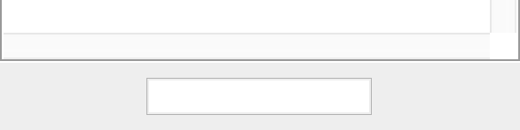
JTextField
JTextField field = new JTextField(10);
add(field, SOUTH);
field.getText(); // returns string in field
field.setText("Marry me");

Slide 31
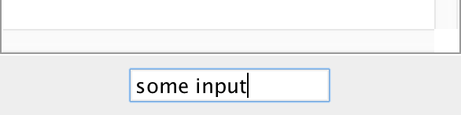
JTextField
JTextField field = new JTextField(10);
add(field, SOUTH);
field.getText(); // returns string in field
field.setText("Marry me");

Slide 32
JTextField
JTextField field = new JTextField(10);
add(field, SOUTH);
field.getText(); // returns “some input”
field.setText("Marry me");

Slide 33
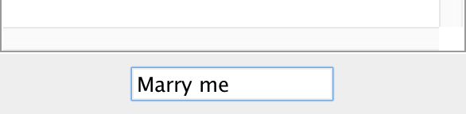
JTextField
JTextField field = new JTextField(10);
add(field, SOUTH);
field.getText(); // returns “some input”
field.setText("Marry me");
*in honor of Carlos, my freshman and sophmore roommate who just proposed

Slide 34
Recall the Dancing Children

Slide 35

Normal Program
Run Method

Slide 36
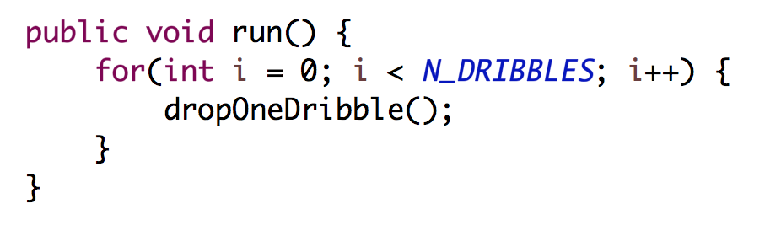
Normal Program
Run Method

Slide 37
Normal Program
Run Method

Slide 38
Normal Program
Run Method

Slide 39
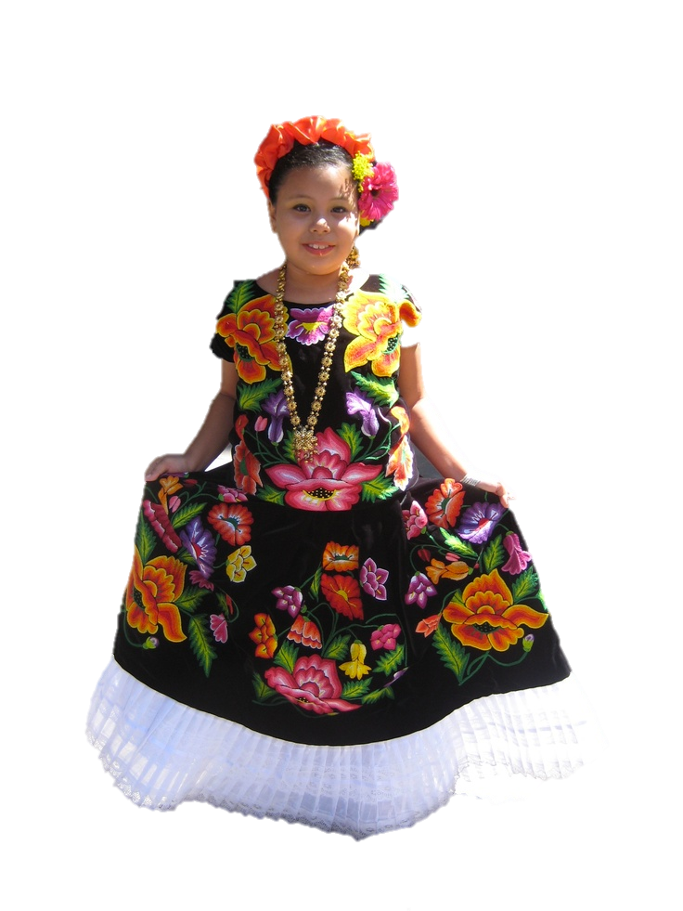
New Listener Characters
Action Listener
Action Performed

Slide 40
Program Starts Running
Run Method
Action Performed

Slide 41
Add Action Listeners
Run Method
Action Performed
Action Listener
addActionListeners();

Slide 42
Program Runs as Usual
Run Method
Action Performed
Action Listener

Slide 43

Button Clicked!
Run Method
Action Performed
Action Listener

Slide 44
Calls Action Performed Method
Run Method
Action Performed
Action Listener

Slide 45
When done, Run continues.
Run Method
Action Performed
Action Listener

Slide 46
Keeps Doing Its Thing…
Run Method
Action Performed
Action Listener

Slide 47
Button Clicked!
Run Method
Action Performed
Action Listener

Slide 48
Calls Action Performed Method
Run Method
Action Performed
Action Listener

Slide 49
When done, Run continues.
Run Method
Action Performed
Action Listener

Slide 50
Recall the Dancing Children

Slide 51
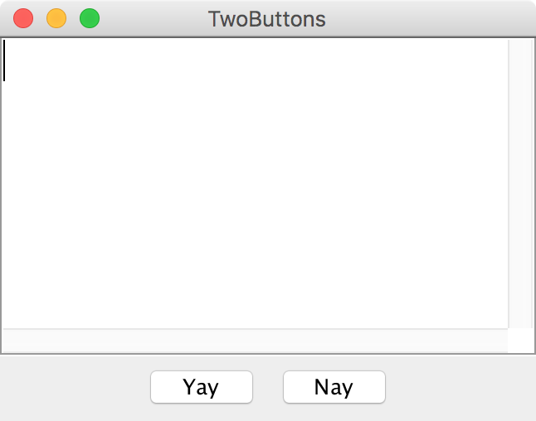
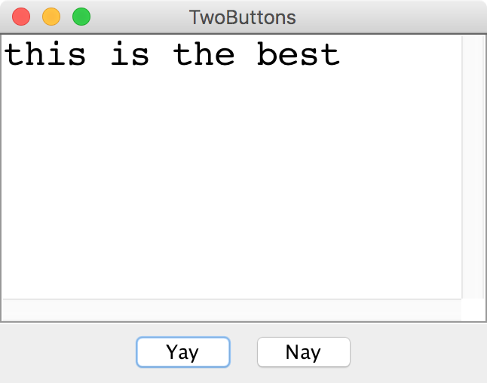
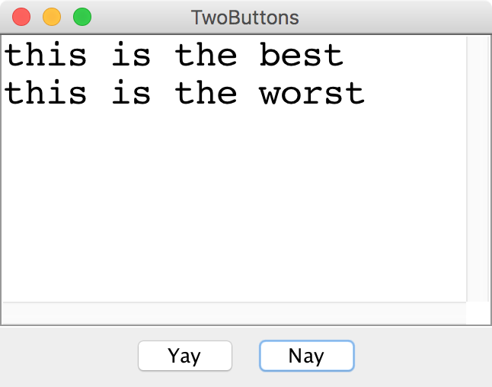
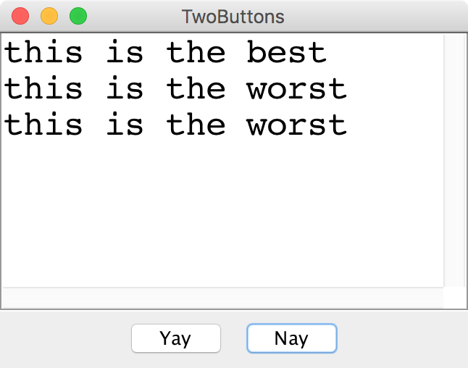
Two Buttons

Slide 52
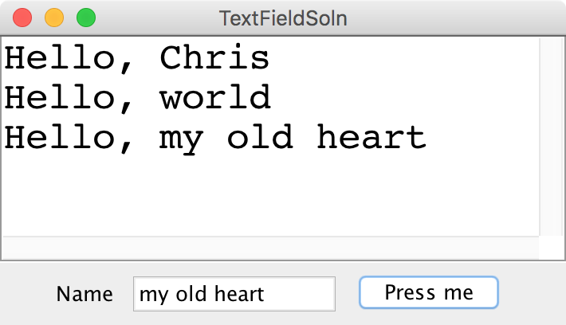
Text Field

Slide 53
Something awesome
*thanks Keith for the idea

Slide 54

The XKCD Color Survey
Notes:
2/24/17
54
54

Slide 55
Notes:
2/24/17
55
55

Slide 56
Notes:
2/24/17
56
56

Slide 57
Notes:
2/24/17
57
57

Slide 58
The XKCD Color Survey
Volunteers (online) were shown a randomly-chosen color and asked to name the color.
The result is (after filtering) about 2.8 million RGB triplets and their names.
What do people think the colors are?
Notes:
2/24/17
58
58

Slide 59
The File Format
color-name,
red,
green,
blue
Notes:
2/24/17
59
59

Slide 60
How to Structure Data
blue
15
137
255
0
0
127
88
88
190
red
166
14
7
99
55
5
255
0
0
gray
154
156
157
243
242
254
140
143
148
associate each color name
with a list of colors
Notes:
2/24/17
60
60

Slide 61
How to Structure Data
blue
15
137
255
0
0
127
88
88
190
red
166
14
7
99
55
5
255
0
0
gray
154
156
157
243
242
254
140
143
148
HashMap<color name, list of colors>
Notes:
2/24/17
61
61

Slide 62
How to Structure Data
blue
15
137
255
0
0
127
88
88
190
red
166
14
7
99
55
5
255
0
0
gray
154
156
157
243
242
254
140
143
148
HashMap<String, list of colors>
Notes:
2/24/17
62
62

Slide 63
How to Structure Data
blue
15
137
255
0
0
127
88
88
190
red
166
14
7
99
55
5
255
0
0
gray
154
156
157
243
242
254
140
143
148
HashMap<String, ArrayList<color>>
Notes:
2/24/17
63
63

Slide 64
How to Structure Data
blue
15
137
255
0
0
127
88
88
190
red
166
14
7
99
55
5
255
0
0
gray
154
156
157
243
242
254
140
143
148
BHashMap<String, ArrayList<Color>>B
Notes:
2/24/17
64
64

Slide 65
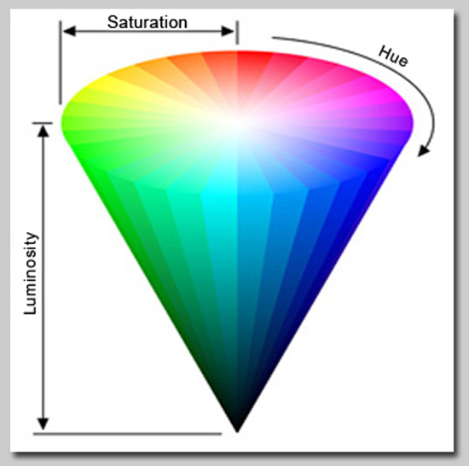
Displaying Colors
HSB color format:
Choose the hue (which color), saturation (how intense), and brightness (absolute brightness).
Each choice in the range from 0.0 to 1.0.
Notes:
2/24/17
65
65

Slide 66
Further Reading
http://blog.xkcd.com/2010/05/03/color-survey-results/
Notes:
2/24/17
66
66

